Slide 1
World Bank Service Indicators Project
John Kellogg
Fall semester 2019

Slide 2
Research question
Using observational study methods, this presentation will identify if a country's "Computer, communications and other technical services" (import and export) are affected by Geographical area and/or prosperity utilizing data generated from The World Bank databank World Development Indicators.
World Development Indicators (WDI) is the primary World Bank collection of development indicators, compiled from officially recognized international sources. It presents the most current and accurate global development data available, and includes national, regional and global estimates.
The data is from 2008 to 2017. (Data from 2018 was incomplete; analysis had to move to the most complete date.)
Within the data there are there are both pre-defined groups and individual countries
Aggregate groups based on Geographical area, political situation, and monetary status.
Focused on Indicators:
Computer, communications and other services (% of commercial service exports) [Dependent variable]
Computer, communications and other services (% of commercial service imports) [Dependent variable]
WDI Metadata to define Geographical position (Qualitative) [Independent Variable]
country's financial status (Quantitative) [Independent Variable]
Commercial Service Import/Export numbers (in $USD)
Each Country's Population numbers (average)
Countries with Blank values for all 10 years have been removed from the dataset.

Slide 3
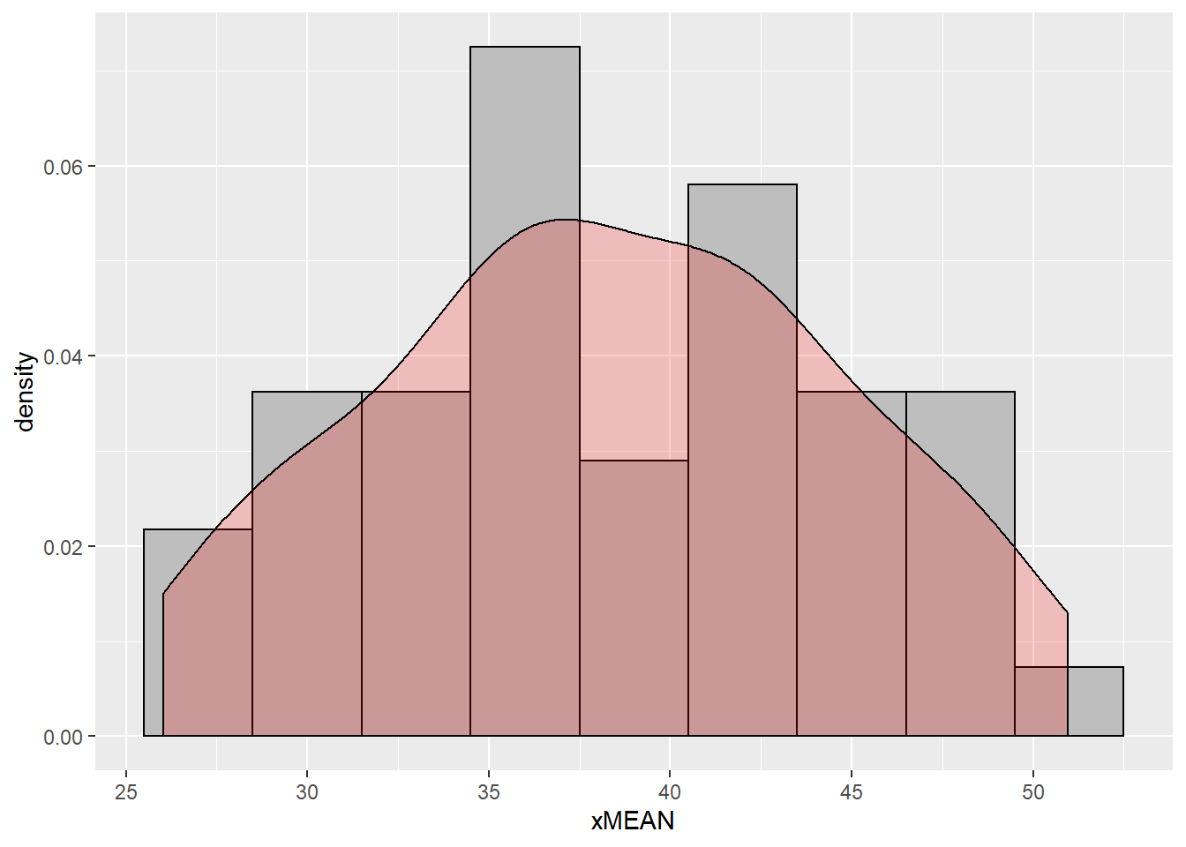
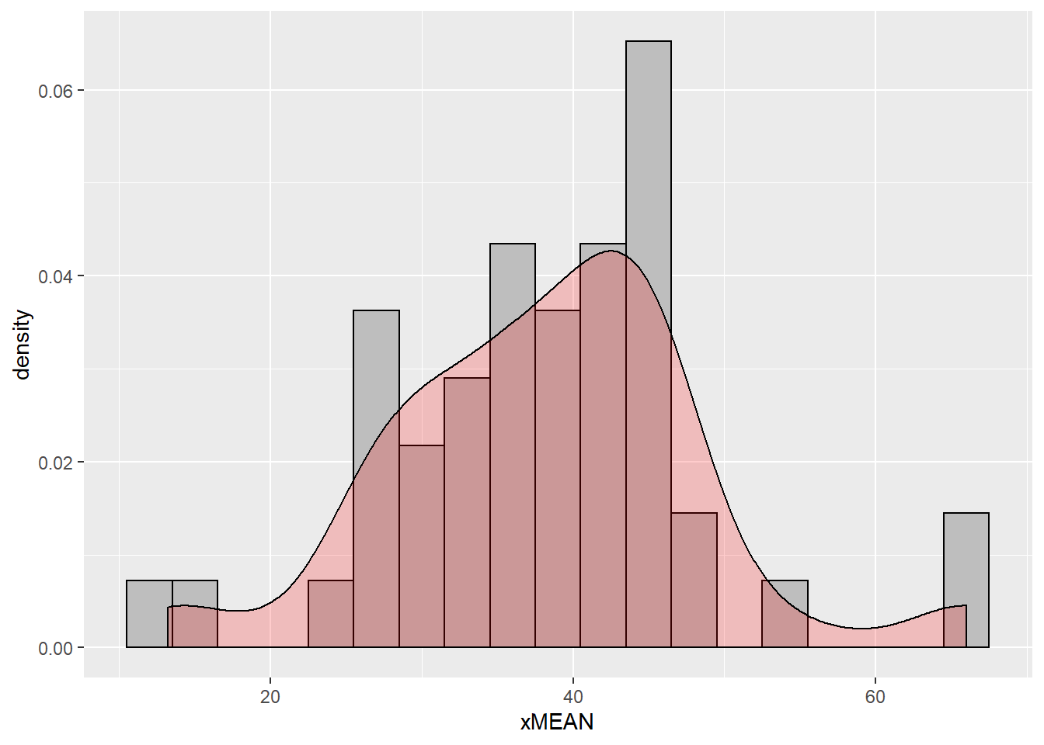
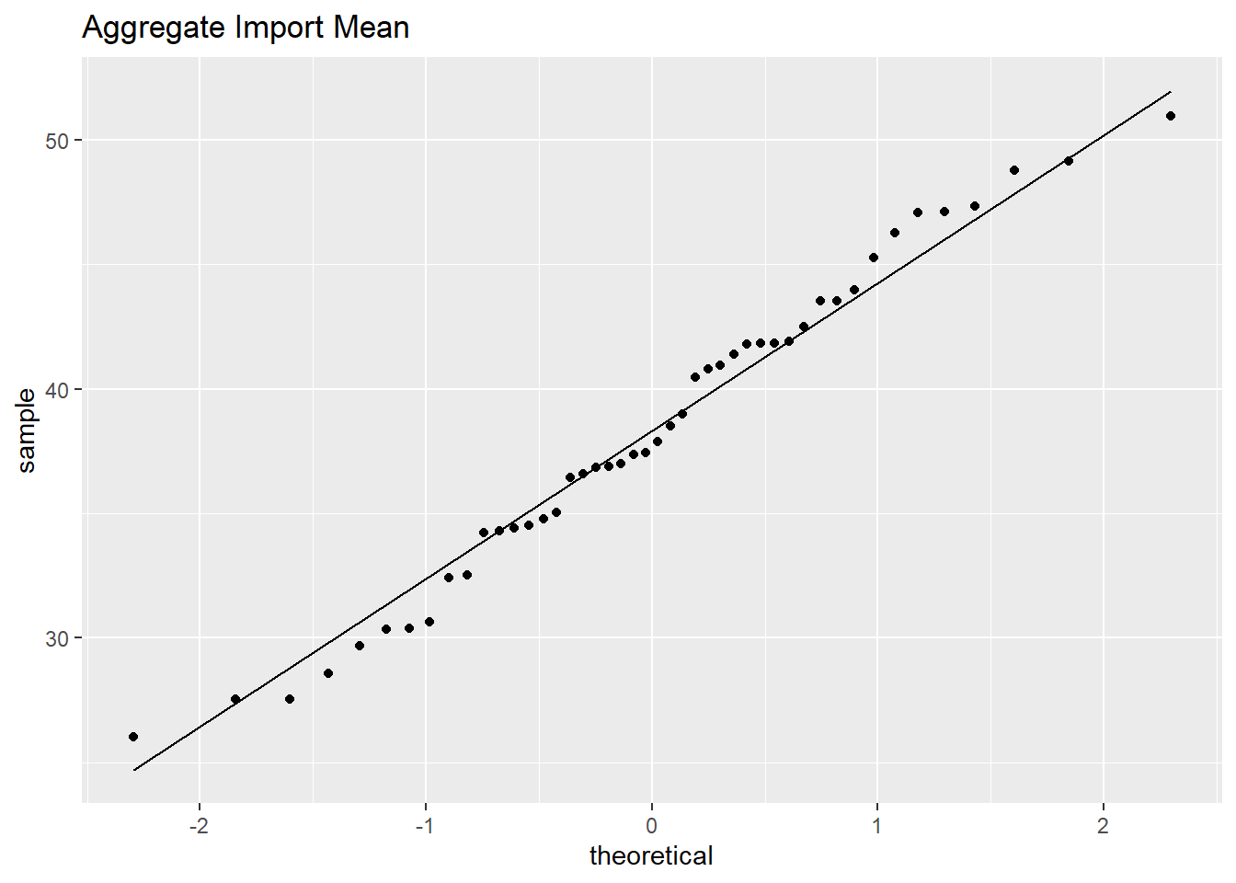
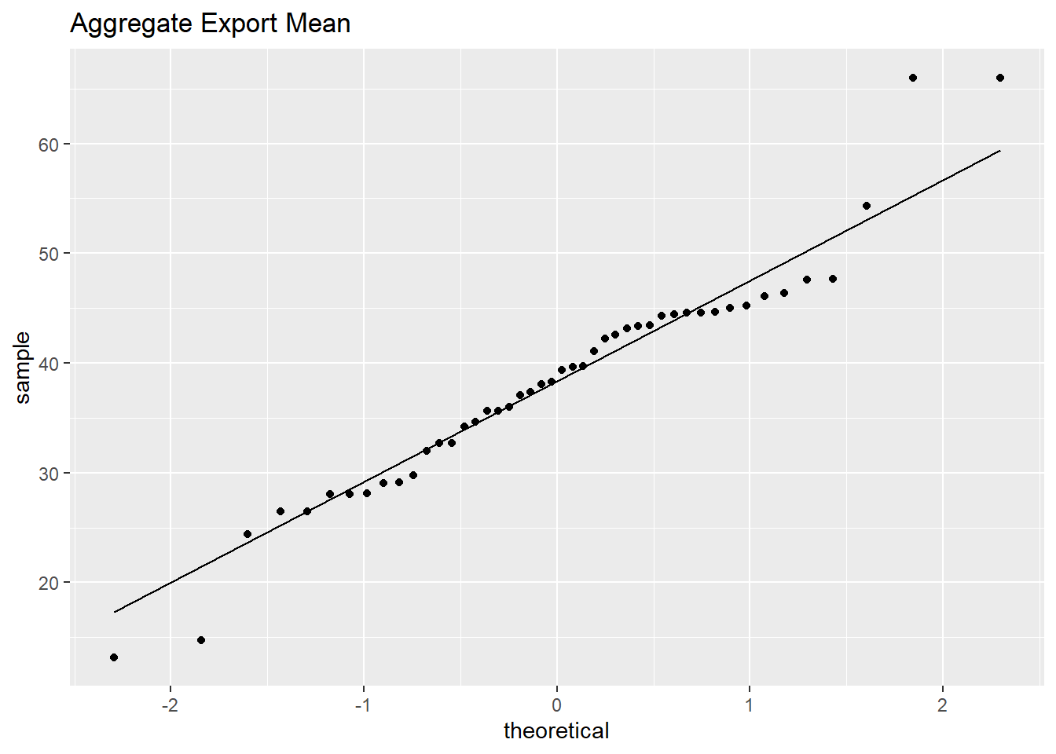
Summary Statistics
The Aggregates are defined as generalized geographical areas as well as groupings by income status. A single country will be in at least 2 aggregates and possibly more as some geographical areas are also broken up by income.
Aggregate Import
40 Unique values
Min: 26.04
1st q: 34.33
Median: 37.67
Mean: 38.34
3rd Q: 42.35
Max: 50.95
Aggregate Export
40 Unique values
Min: 13.20
1st q: 32.17
Median: 38.82
Mean: 38.32
3rd Q: 44.55
Max: 66.01
Notes:
40 aggregates
The Aggregate import follows most of the same normal distribution with a slight left skew. Since they are a full mix of geographical and income groups, we can not rely on the histogram.
The Aggregate export follows does not follow any normal distribution. The same problem as above holds, this dataframe is a full mix of geographical and income groups, we can not rely on the histogram. We will need to evaluate if it still follows the requirement of Inference or Regression after we break the dataframe down further.
The data seems to stick pretty close to the Stat line. There appears to be Heavy outlines on the Export graph

Slide 4
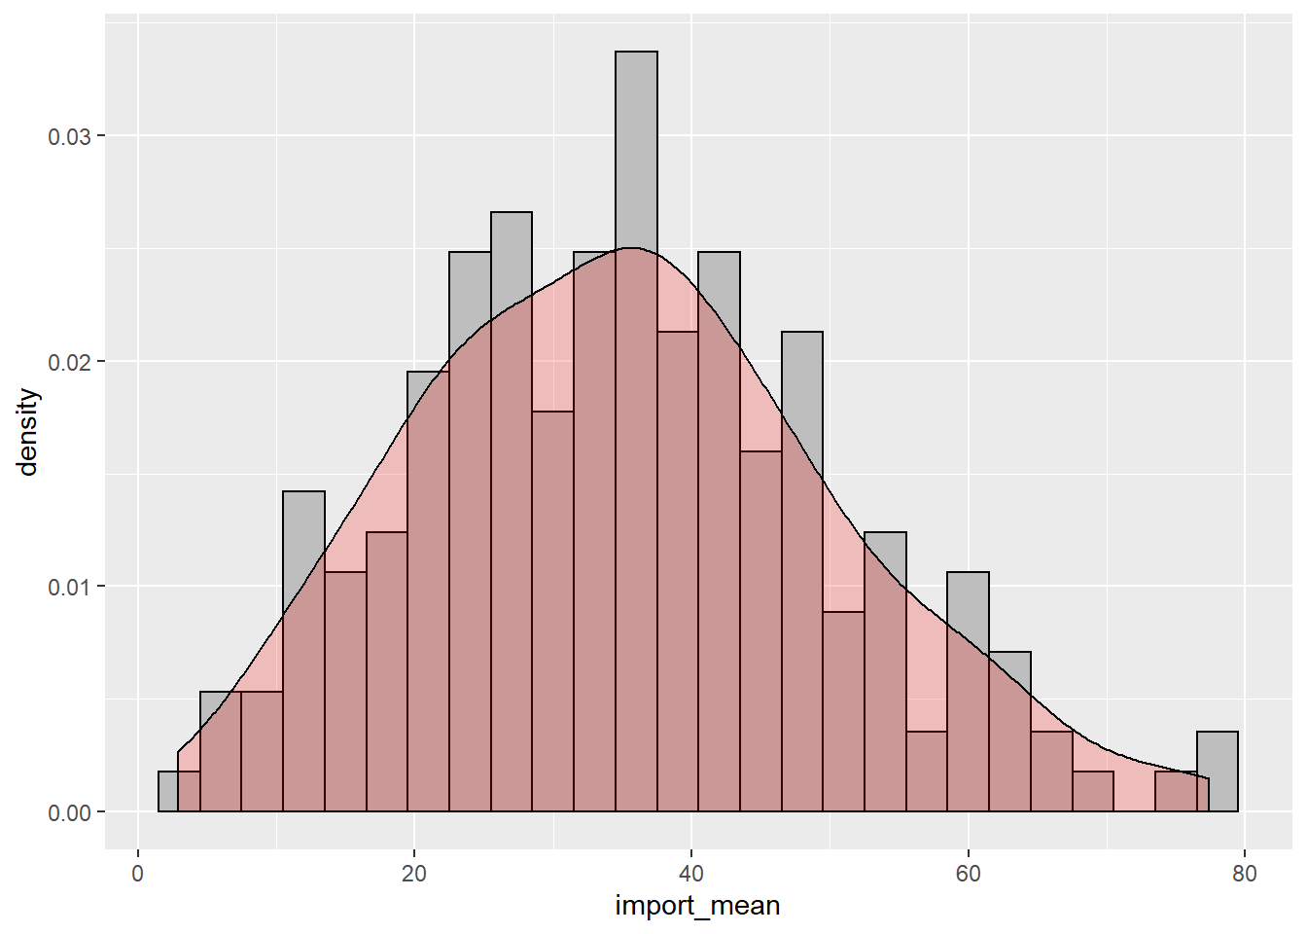
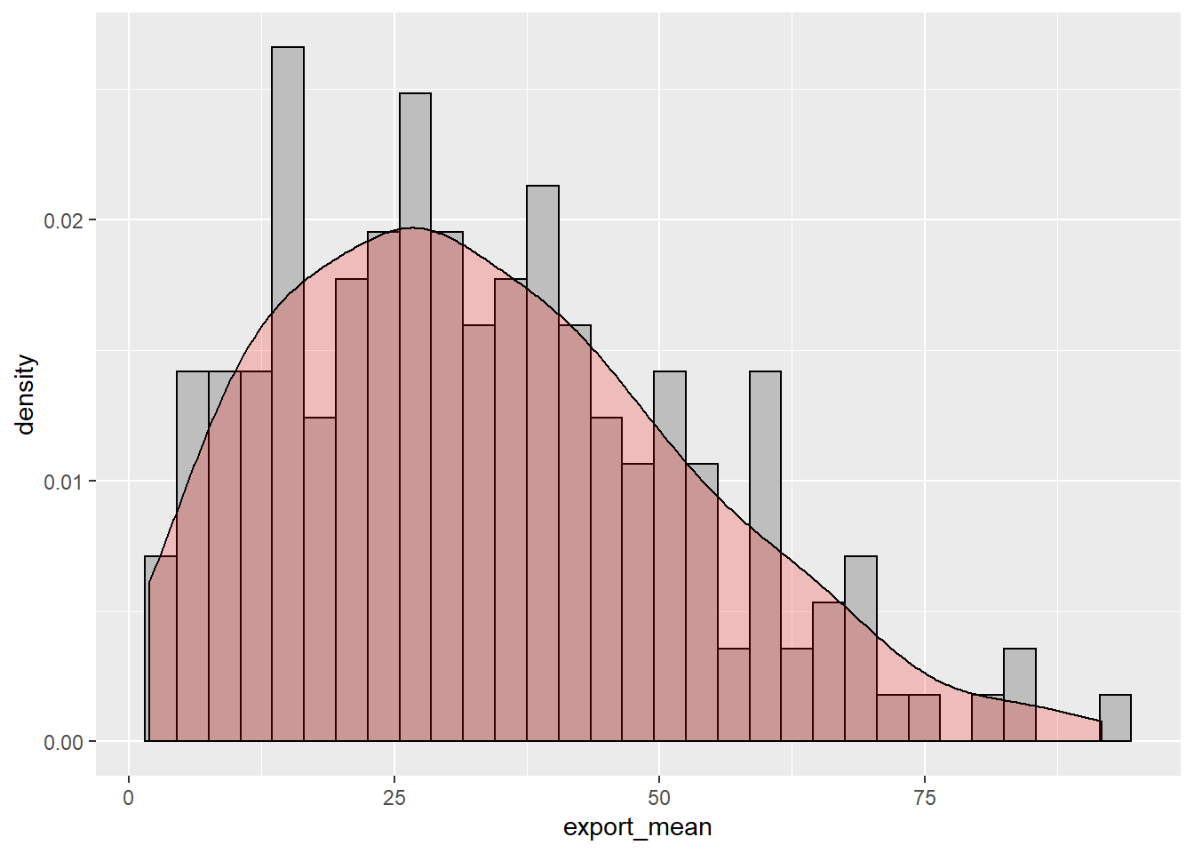
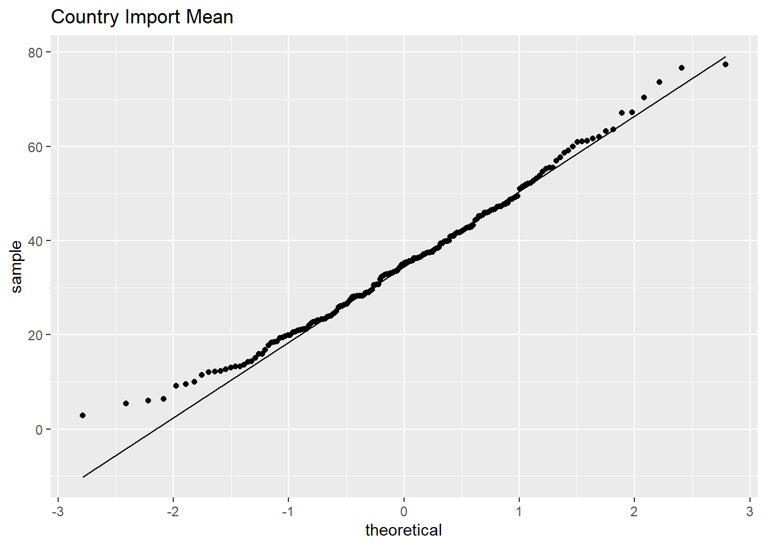
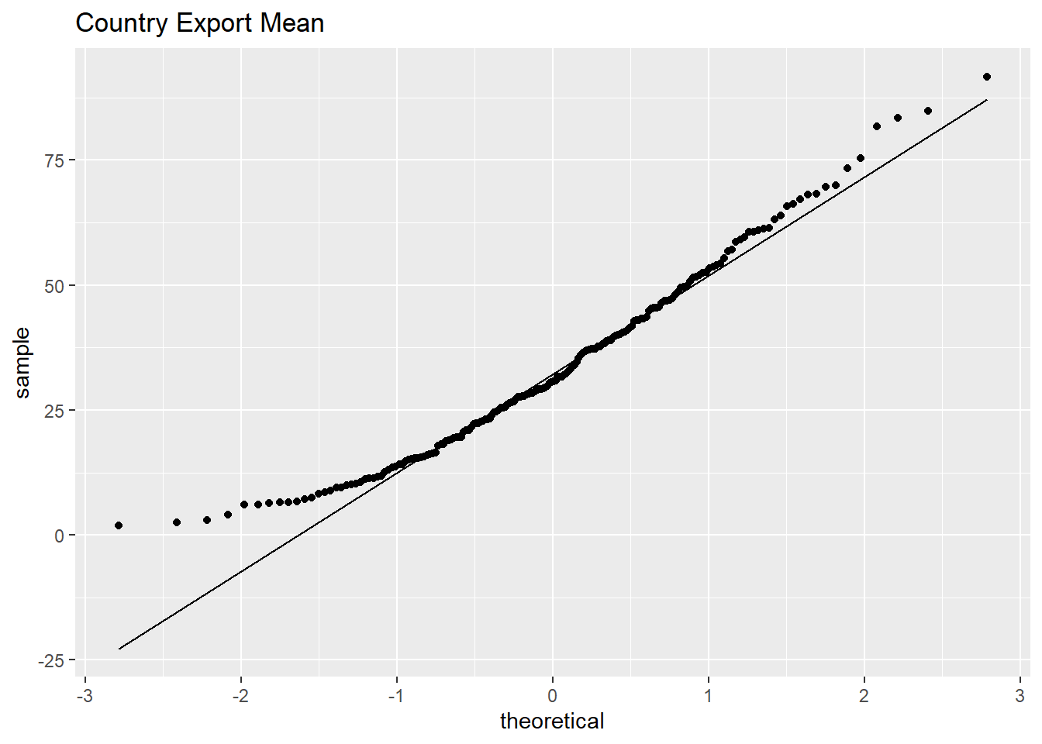
Summary Statistics
The below tables gives us insight into the main focus of the report percentage of the commercial export used for Computer, communications and other services export/import data frames.
Country Import
188 Unique values
Min: 2.913
1st q: 23.692
Median: 35.093
Mean: 35.208
3rd Q: 45.289
Max: 77.343
Country Export
188 Unique values
Min: 1.924
1st q: 18.958
Median: 30.661
Mean: 33.519
3rd Q: 45.554
Max: 91.718
Notes:
188 countries
The general import percentage figures by country and the resulting graph to follow a normal distribution and observations are independent.
The general export percentage figures by country and the resulting graph shows the observations are independent, however, the normal distribution has a right skew. This may be overcome later by pulling a random sample.
Q/Q plots (quantile-quantile) show a definite curve in both means toward the lower end. We will continue to investigate as the lower end curves toward 0. It is impossible in the data to go below a 0% percentage.

Slide 5
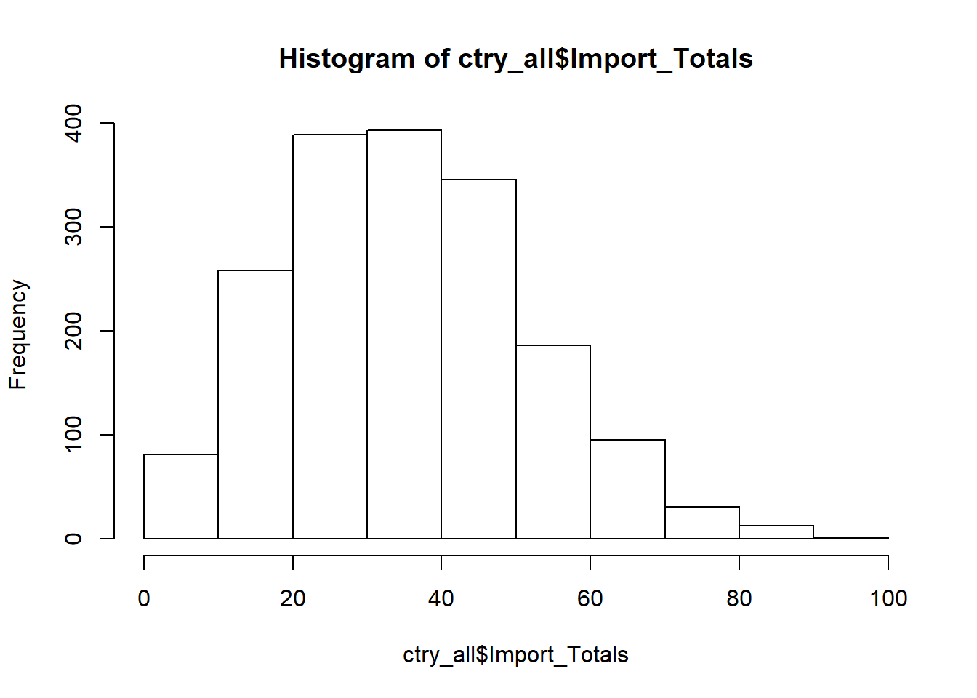
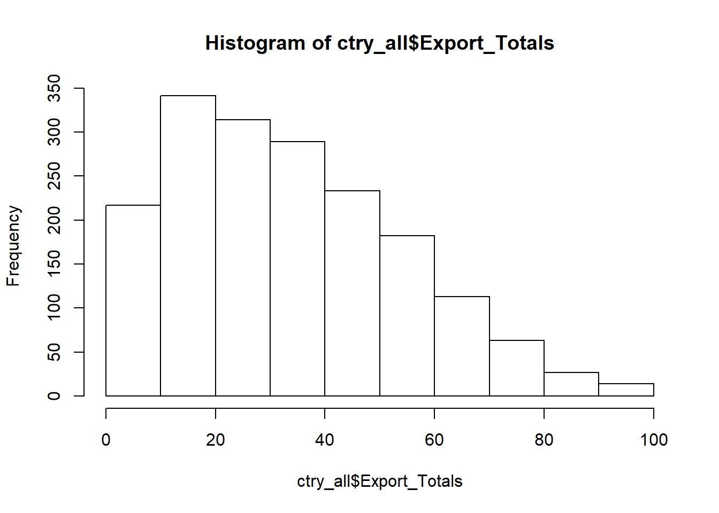
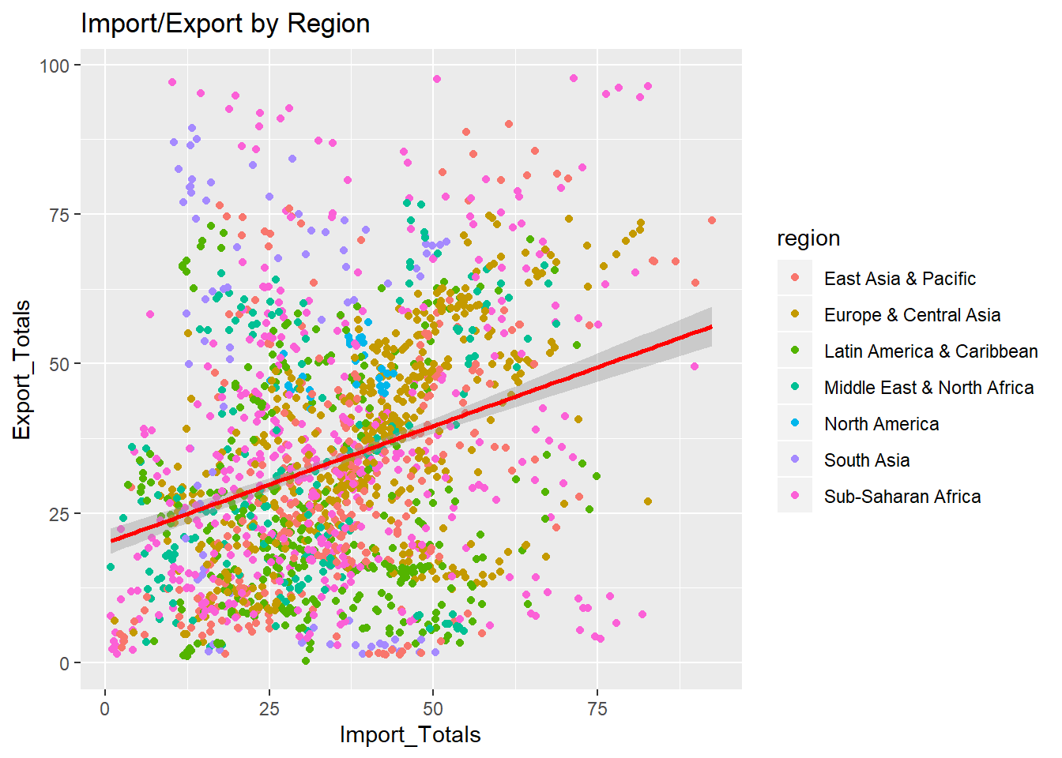
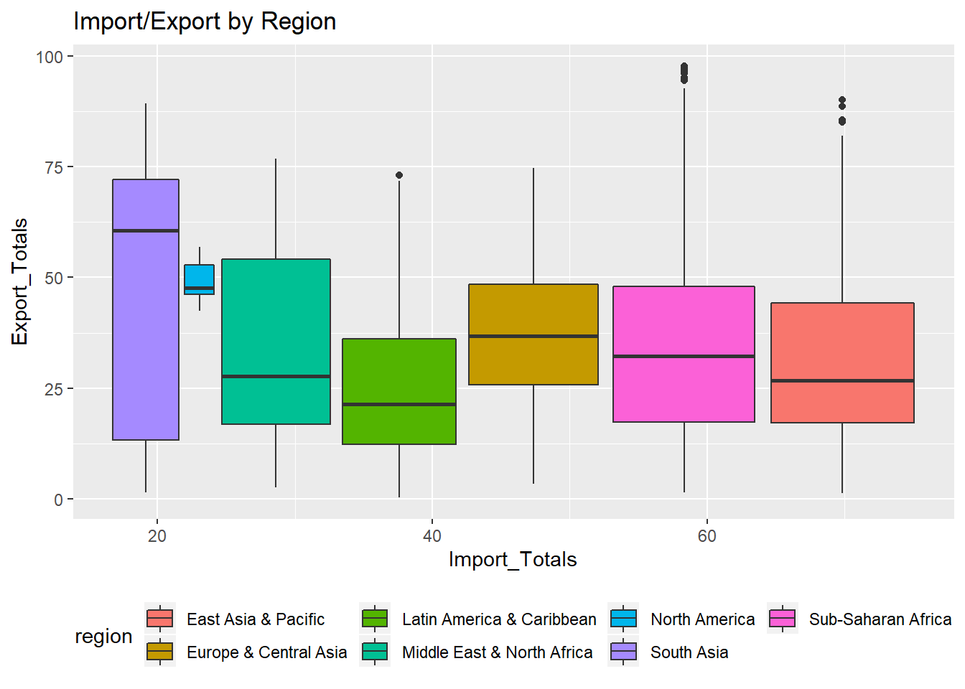
Geographical Analysis
H0:β1−A1=0
H0:β1−A1≠0
Both of the Histograms show a heavy right skew
Definite linear trend but with heavy outliers
South Asia and North America do not follow the model of the other regions
The Regions are:
South Asia
Europe & Central Asia
Middle East & North Africa
Sub-Saharan Africa
Latin America & Caribbean
East Asia & Pacific
North America
Notes:
The first section of the research question we will tackle is location; does a countries geographical location indicate higher or lower Computer, communications and other services (% of commercial service exports) and/or Computer, communications and other services (% of commercial service imports)?
In order to prove this, we should be able to take any country and compare the import and export numbers to the other countries in the aggregate area. If they are near similar, we can comfortably prove the theory.
Looking at the data for all the countries broken down by Import and export, there is a definite right skew in both and Export being far more skewed. We don’t want to only reply on this simple histogram to reject or fail to reject the hypothesis.

Slide 6
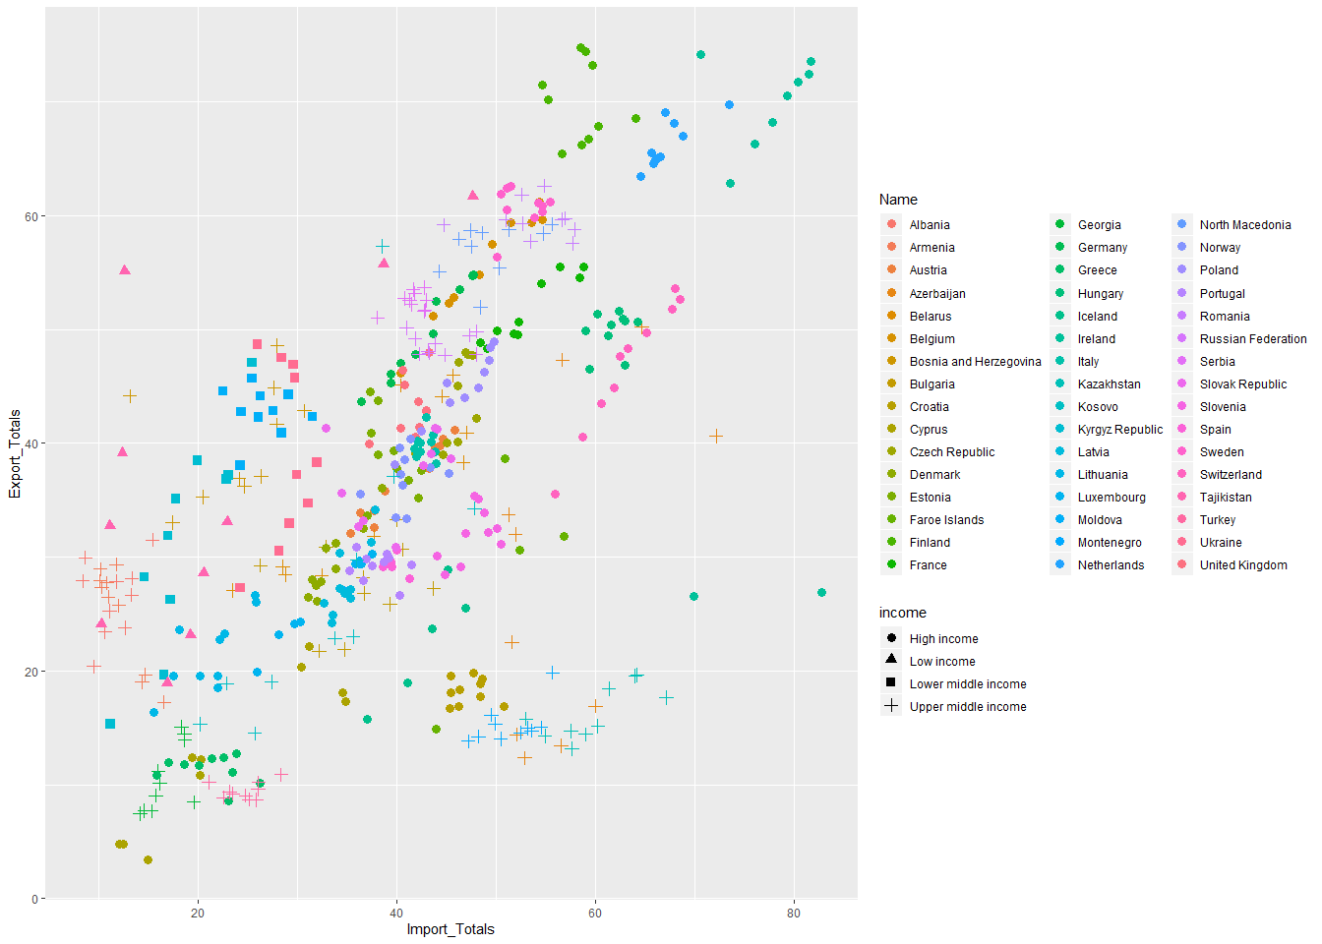
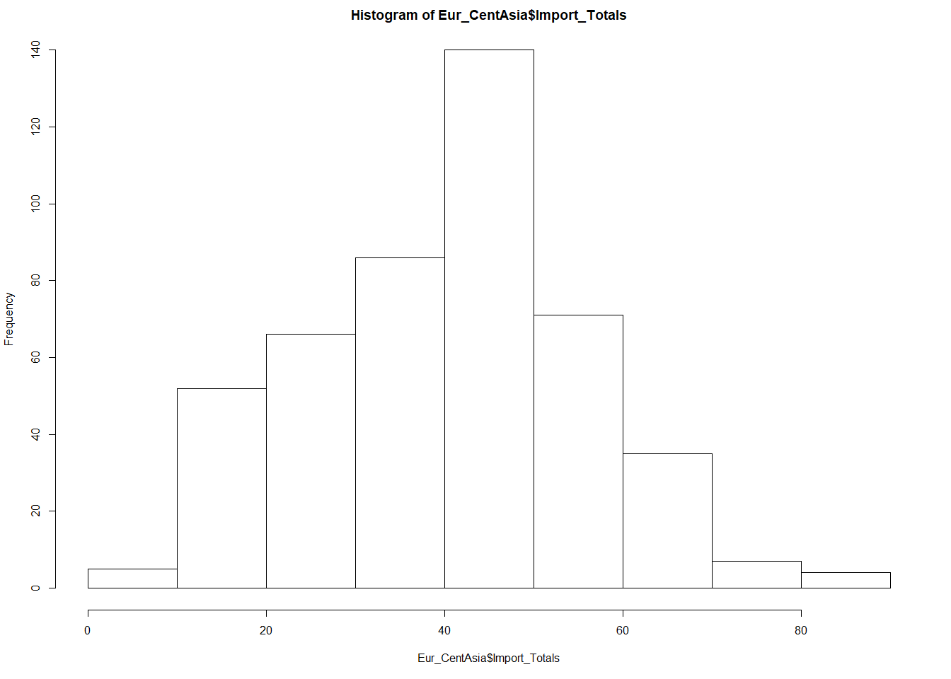
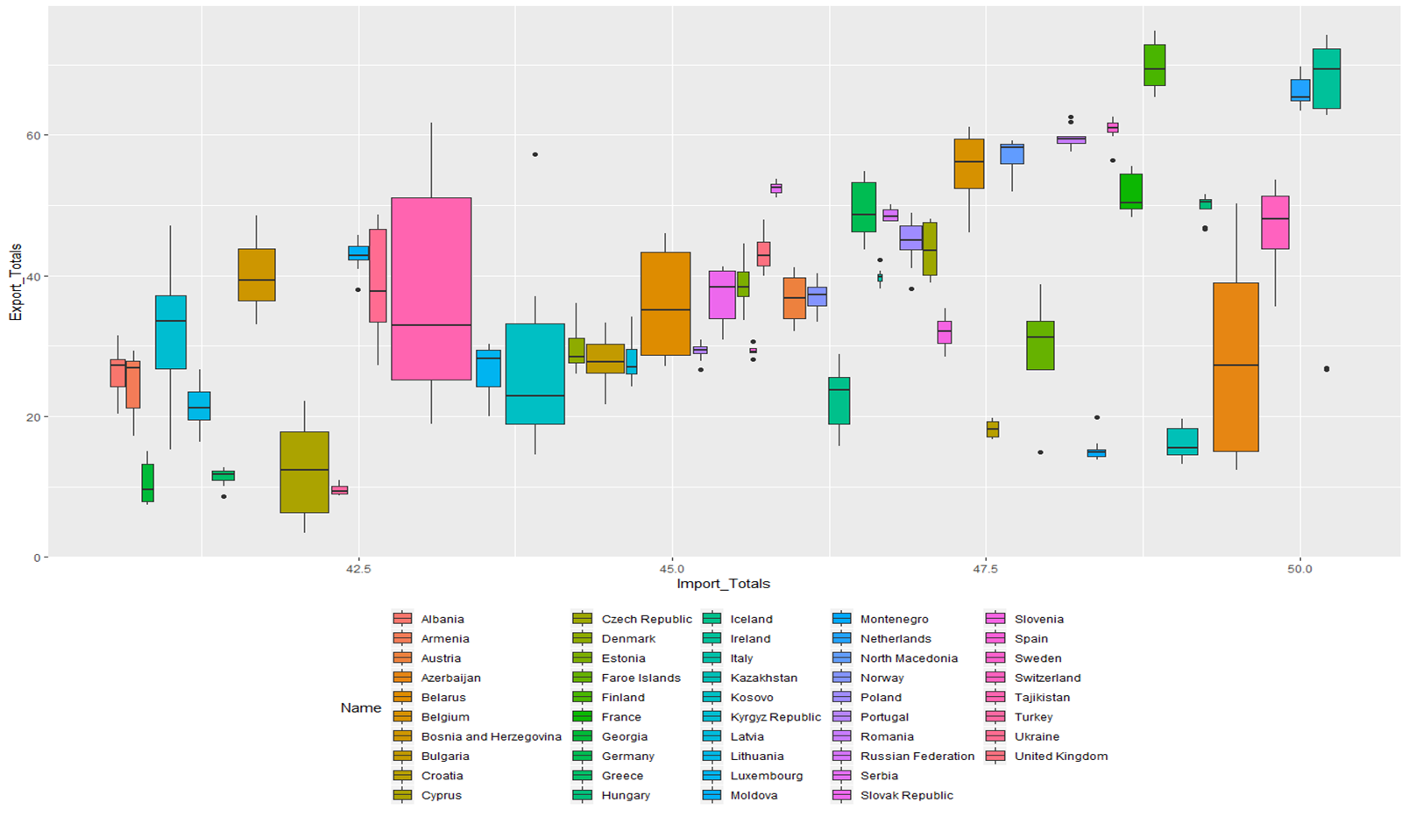
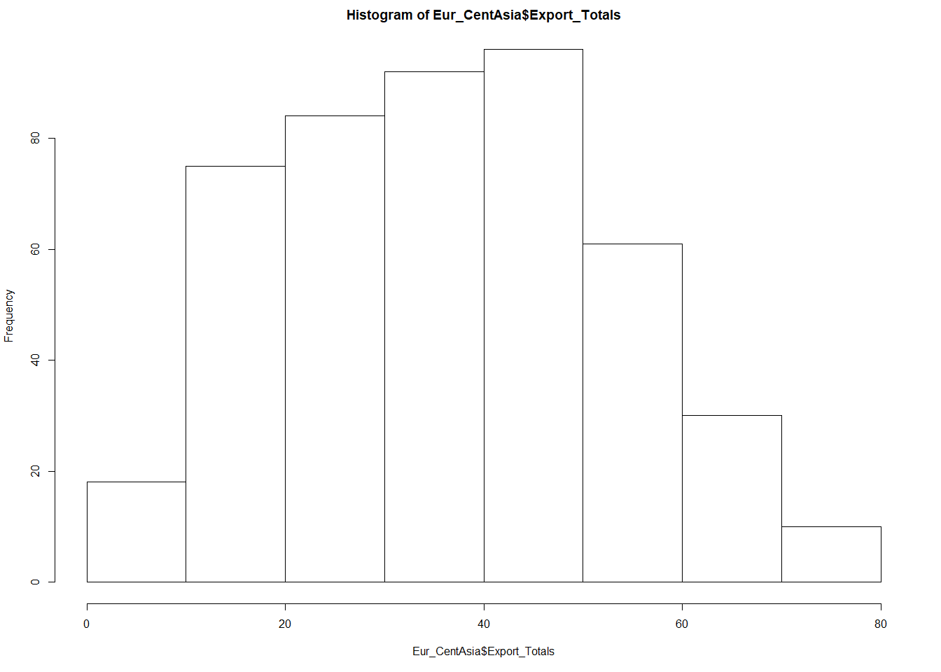
Europe & Central Asia
Import Totals
Export Totals
Notes:
Model of standard
Import totals follow a good normal distribution
Regions follow a linear model
Good mix of high and low import/export

Slide 7
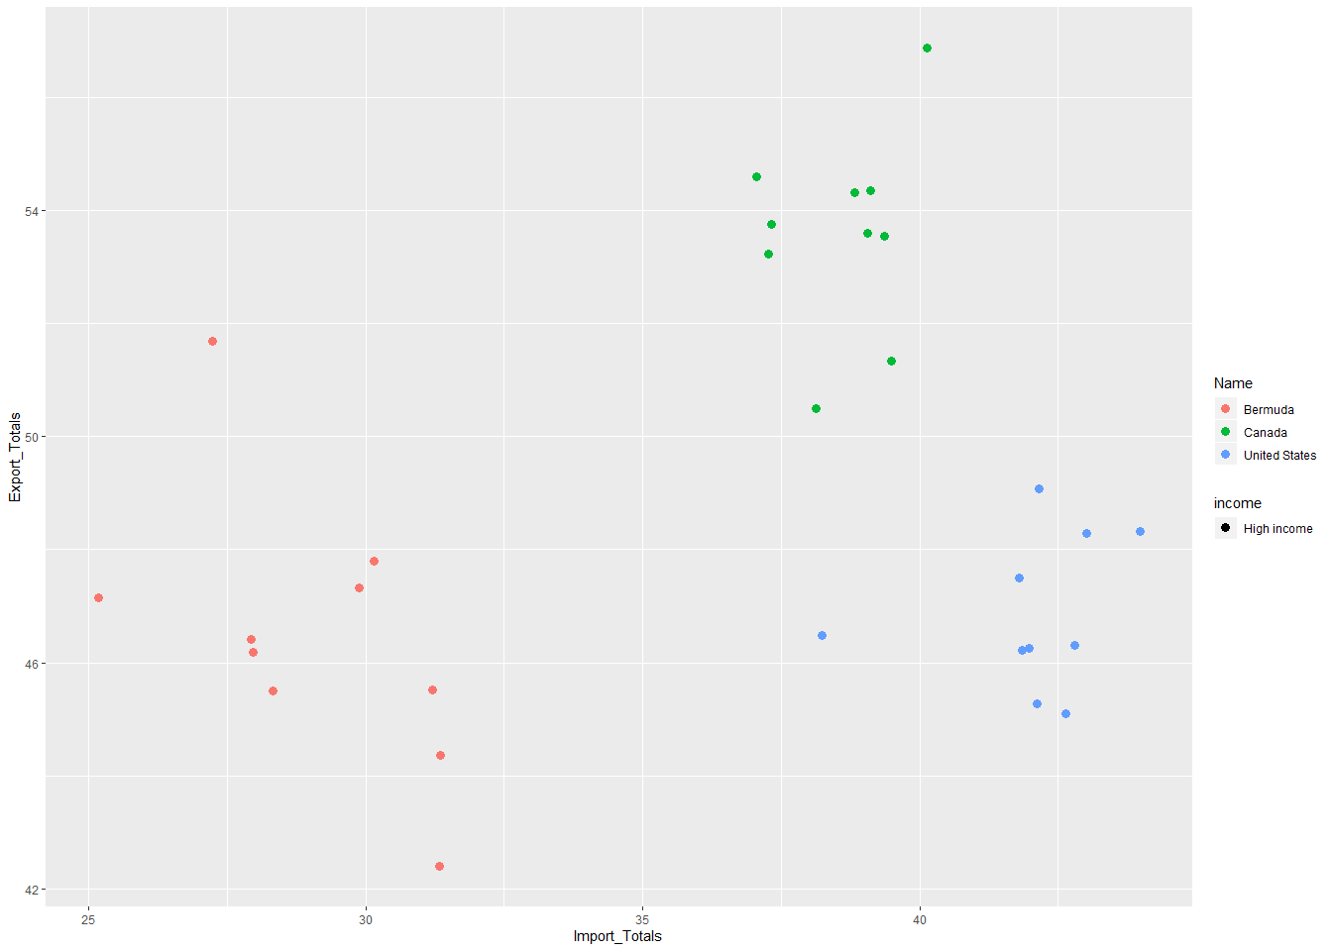
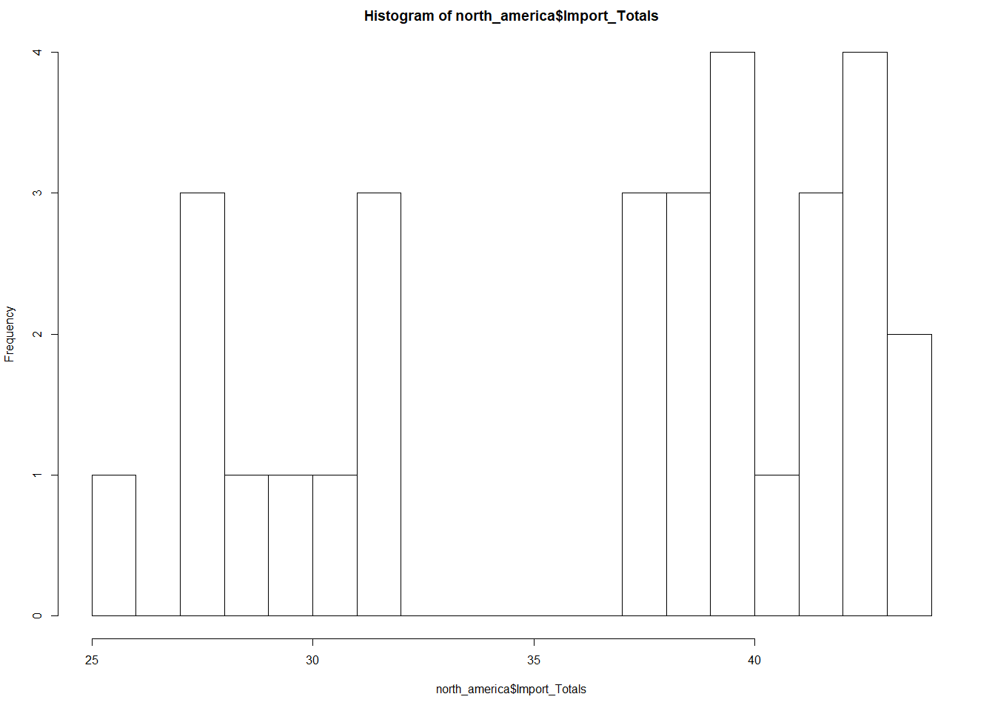
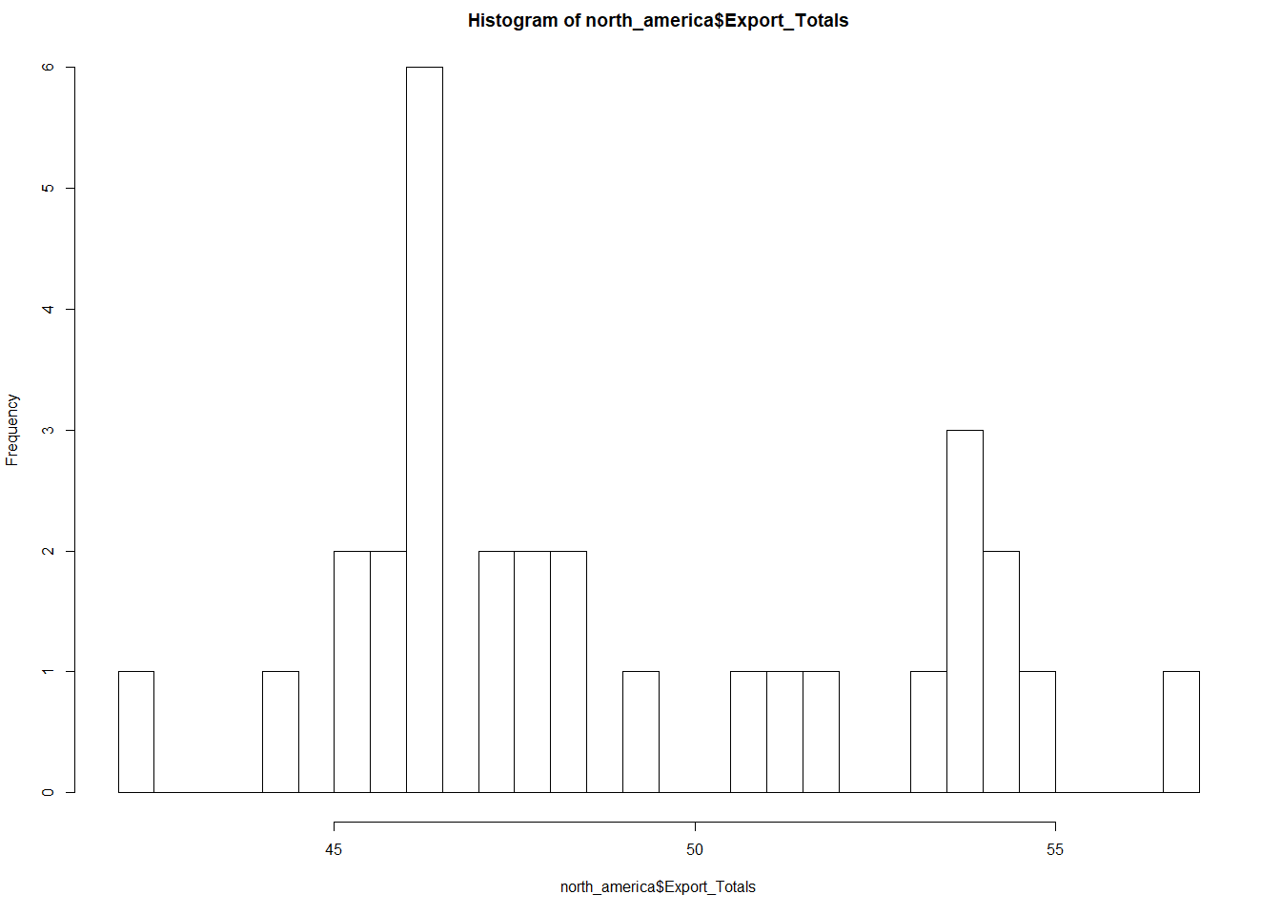
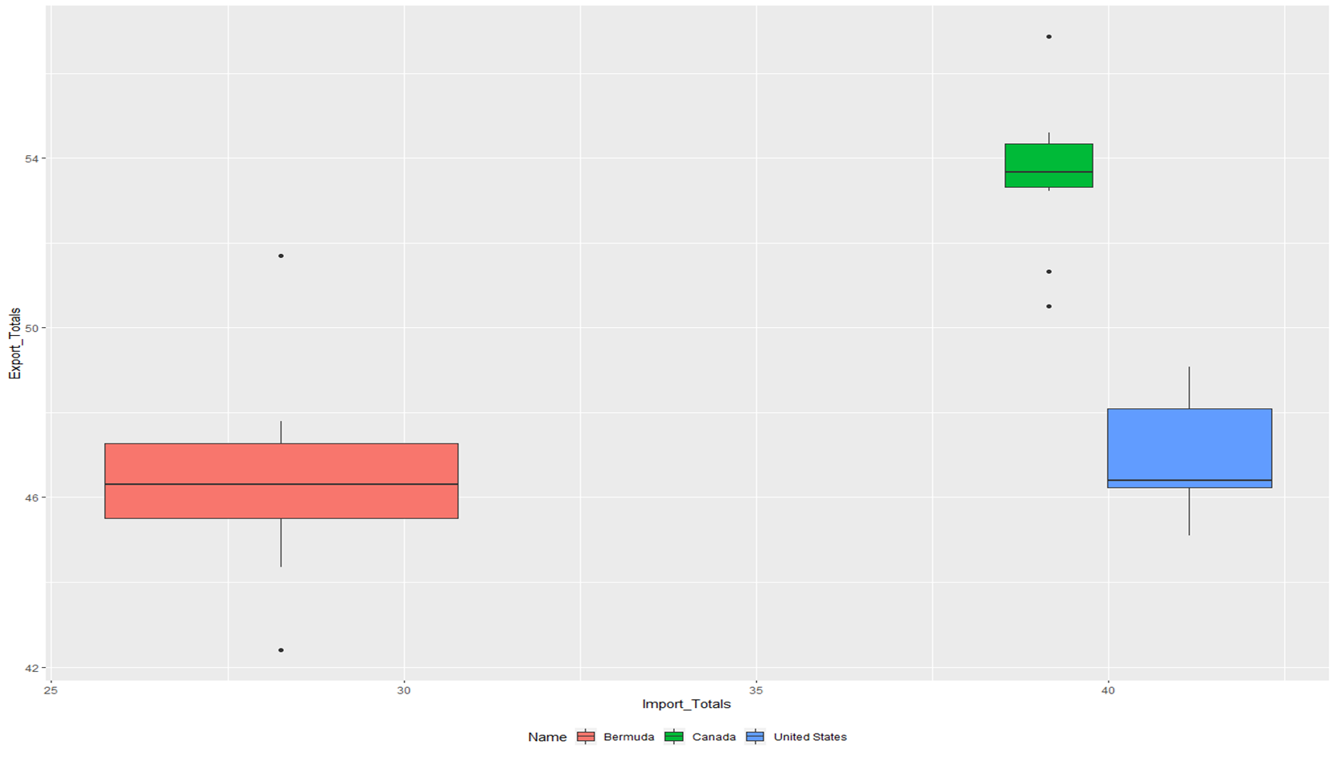
North America
Import Totals
Export Totals
Notes:
Import and Export totals do NOT follow a normal distribution
Region has NO linear model
Not a good mix of high and low import/export

Slide 8
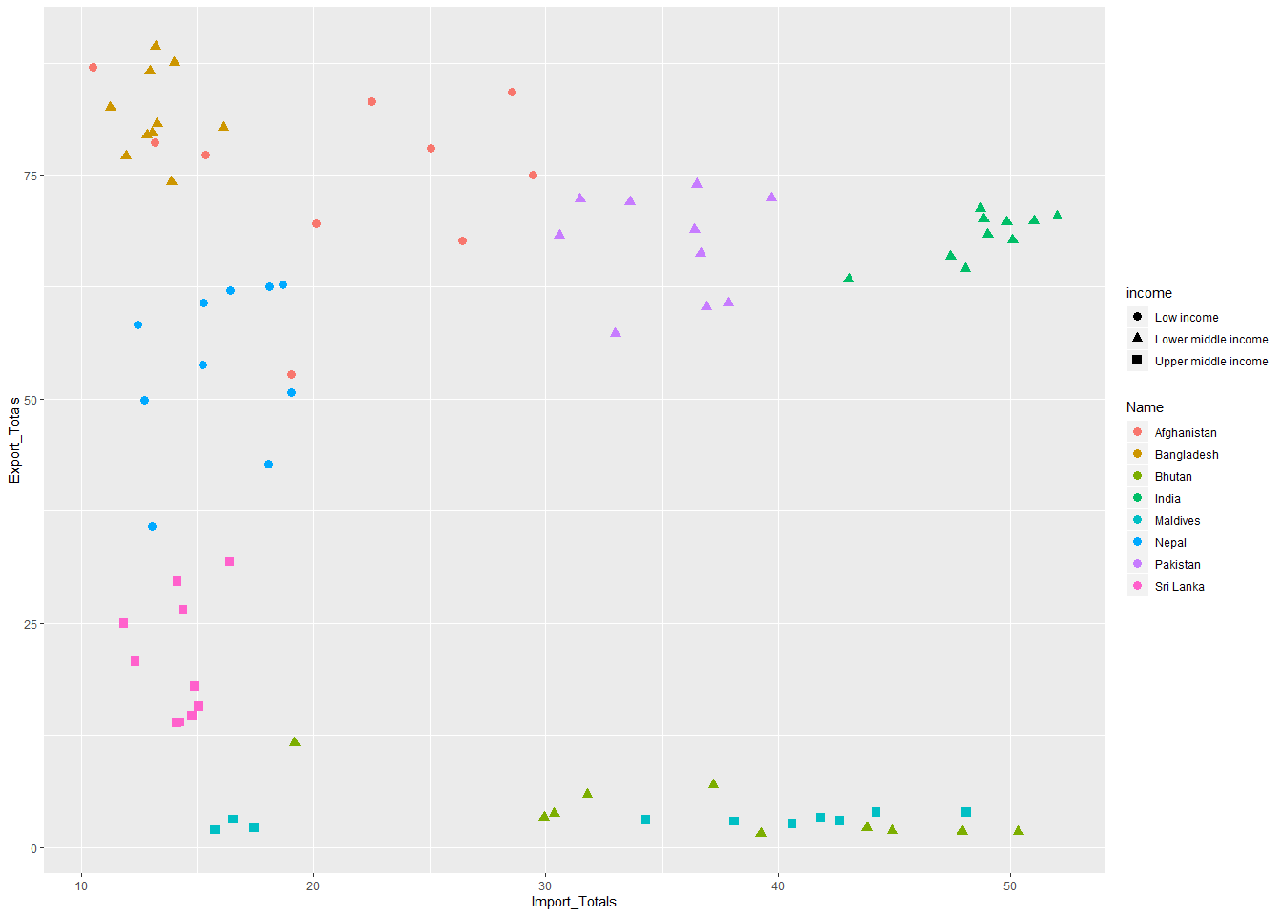
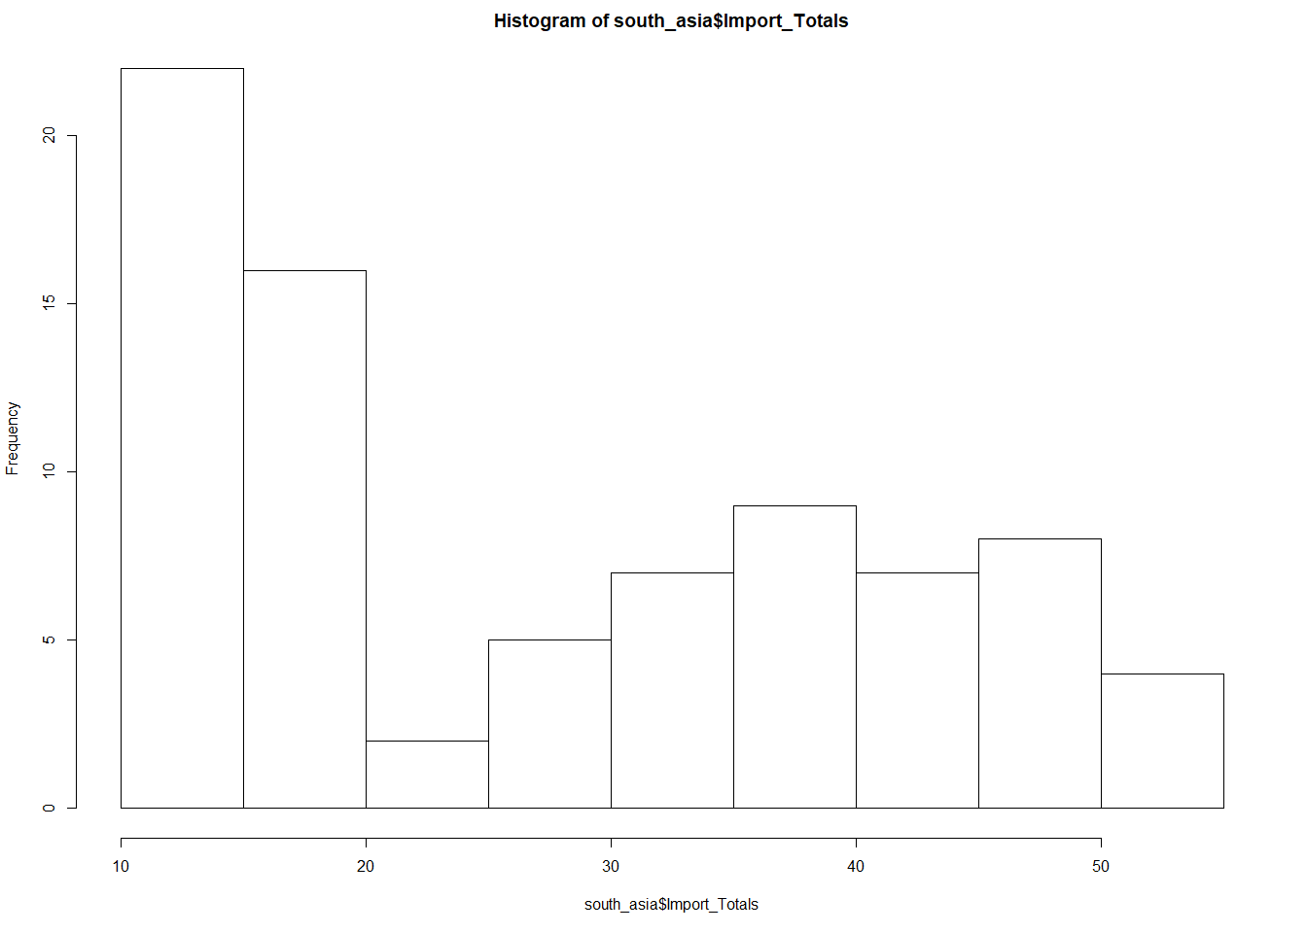
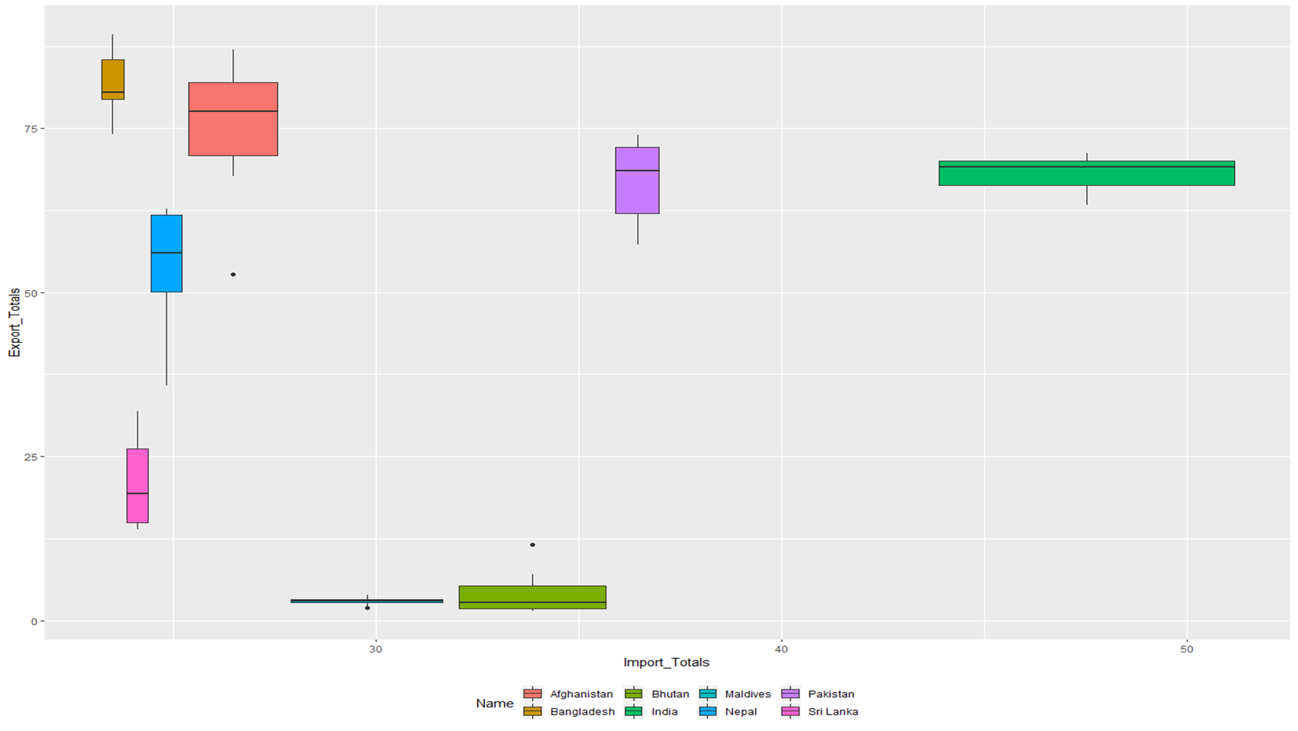
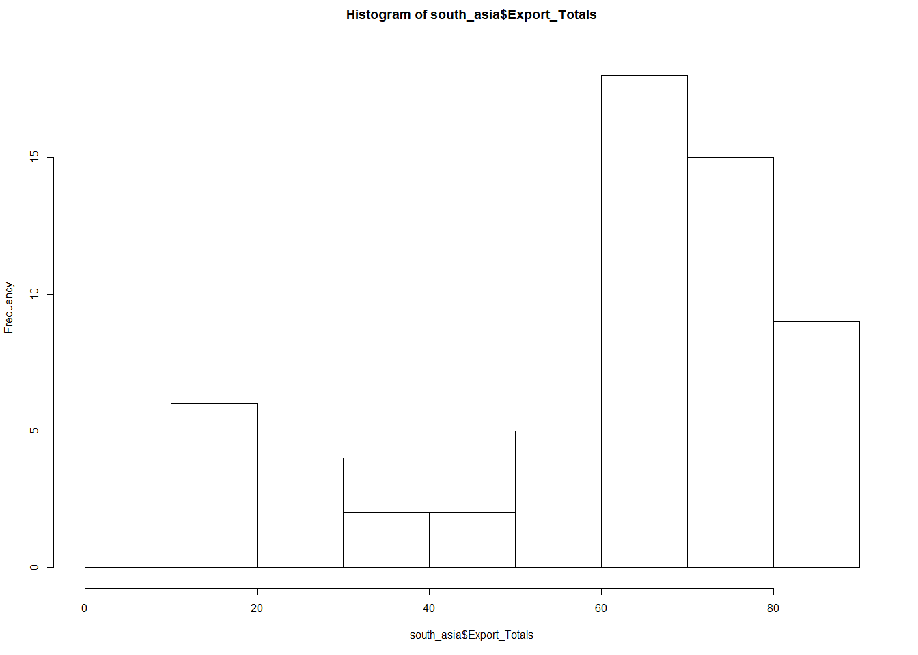
South Asia
Import Totals
Export Totals
Notes:
Import and Export totals do NOT follow a normal distribution
Region has NO linear model
Not a good mix of high and low import/export
With this data in hand, there is no need to for further analysis. We can reject the null hypothesis. The aggregate area country is in does not have effect on their import and export percentage.
We will visit this again

Slide 9
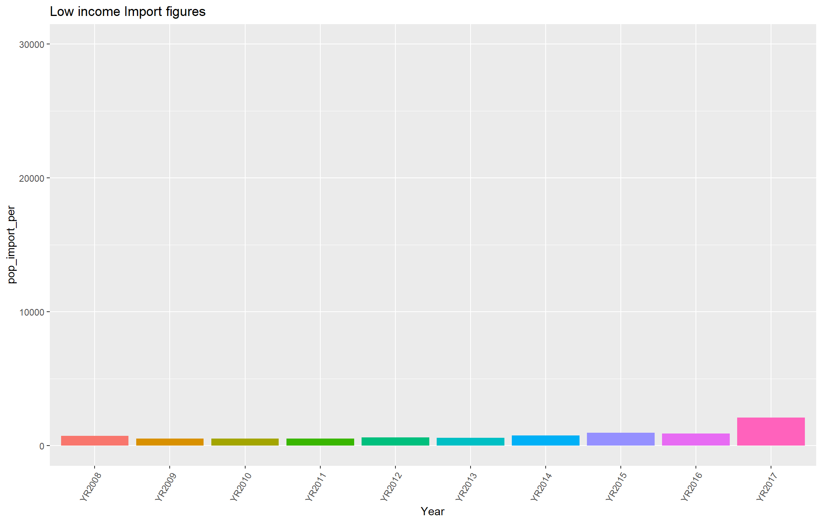
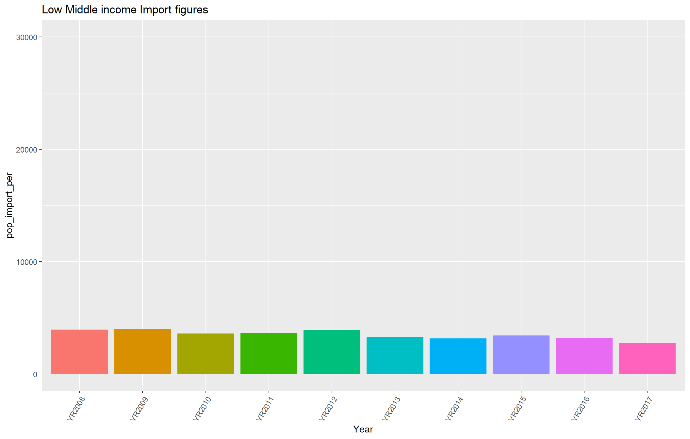
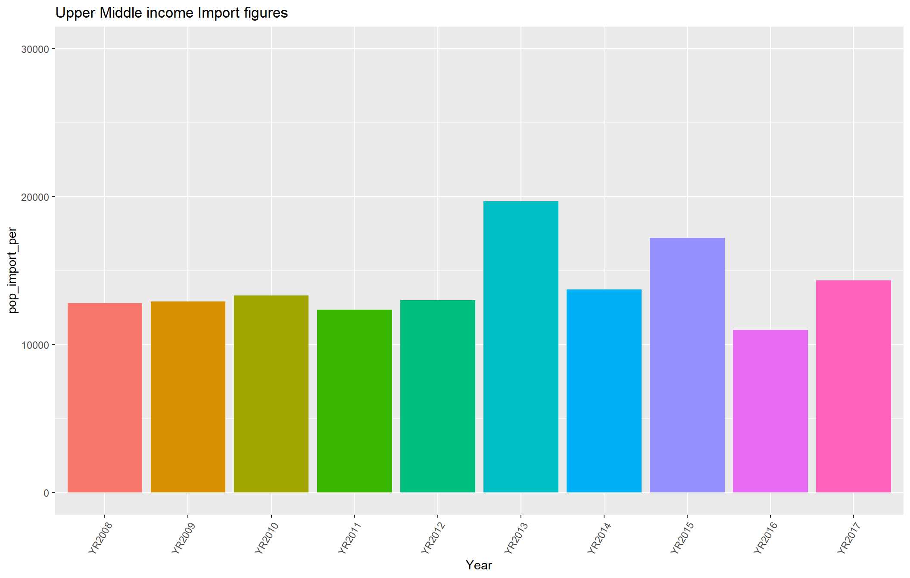
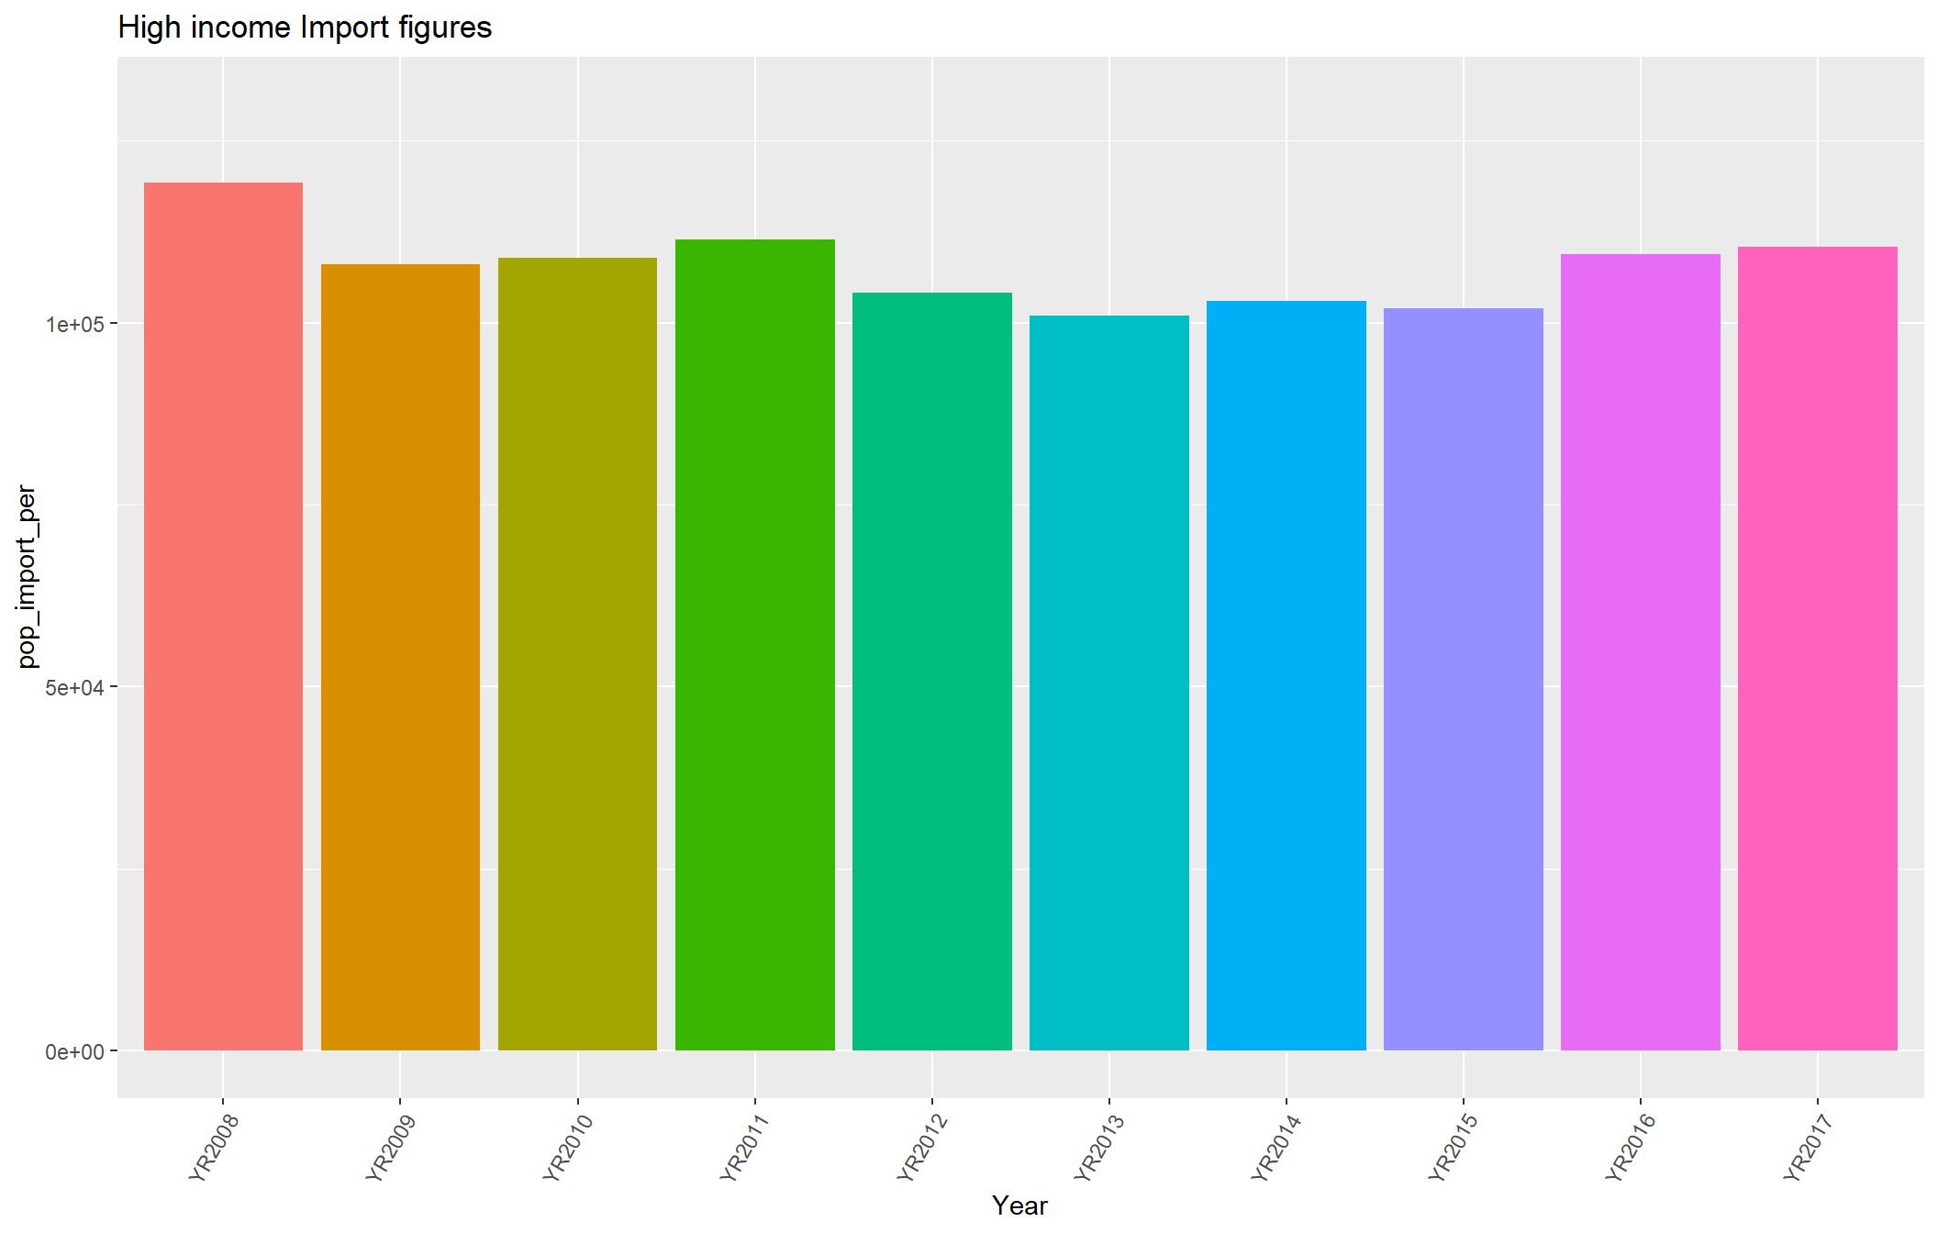
Income Analysis – Location and population
Population/ % value
The income groups are:
* Low income * Lower middle income * Upper middle income * High income
Note: scale of the High income changed from 30,000 to 130,000 In order to show all the data.
Notes:
The second section of the research question we will tackle Income based analysis; does a countries general Income indicate higher or lower Computer, communications and other services (% of commercial service exports) and/or Computer, communications and other services (% of commercial service imports)?
In order to prove this, we should be able to take any country and compare the import and export numbers to the other countries in the aggregate area. If they are near similar, We can comfortably prove the theory.
The inherent flaw in the logic of comparing all “High” income countries to each other is we will need to compare Liechtenstein (population ~ 35,727) with Germany (Population ~ 82,657,002). Both are in the same aggravate in both location and income. To even out the comparison, the population figures for each country was pulled; a calculation of amount (in USD) per person was performed.
Average per person of $1000 of Commercial Service Import/Export and the country figures are 35% for our investigation than the average used is $350.
With all the data in one dataframe, we are able to look at the per person average import/export of Computer, communications and other services. The numbers presented below will represent dollar amount (in USD) based off of the percentage used earlier. It should even out the extreme population variance.

Slide 10
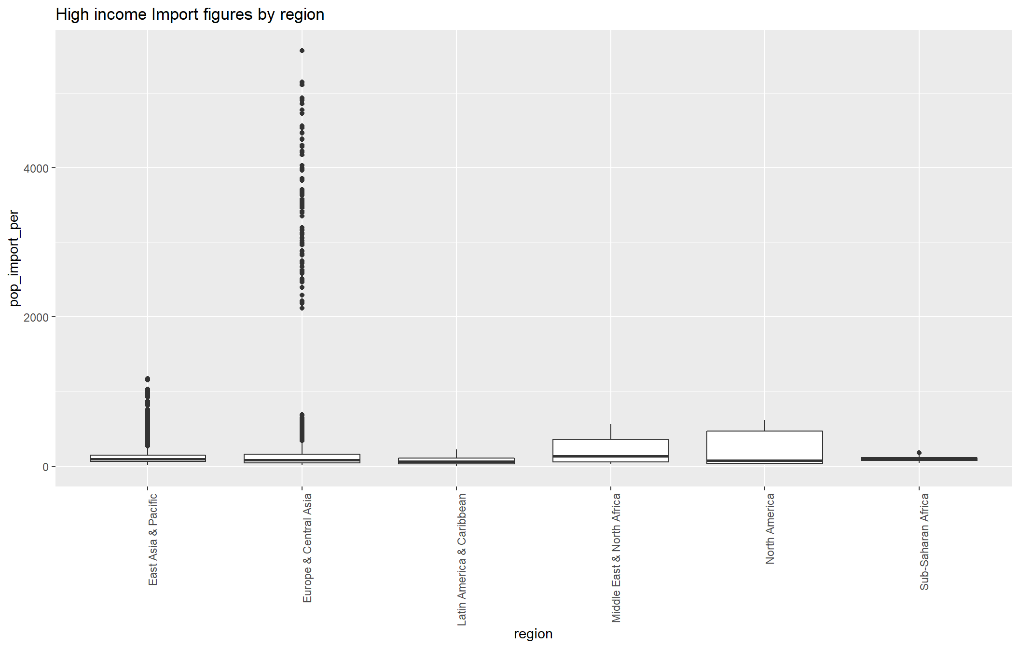
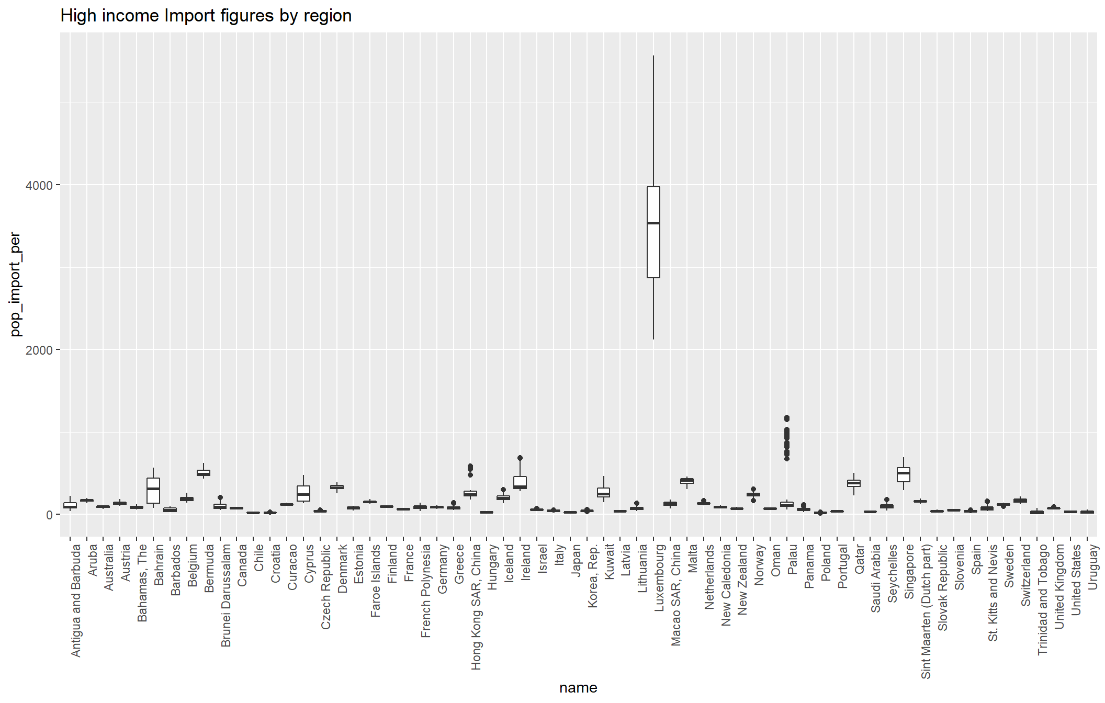
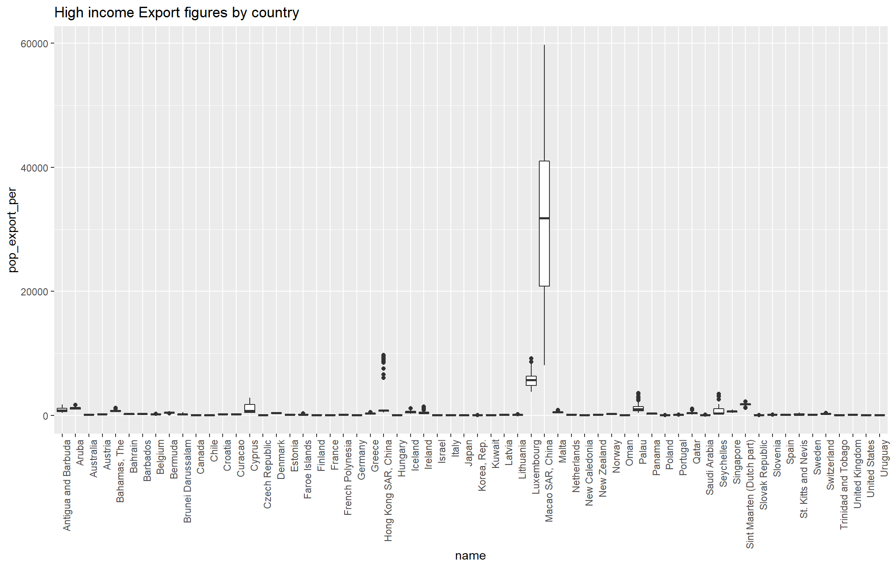
Income Analysis – High Income
Europe & Central Asia
Europe & Central Asia
Luxembourg
China
Notes:
We know High income countries make up a majority of our dataset. Running modeling across the high income countries should allow us to determine if we are keeping the hypothesis.

Slide 11
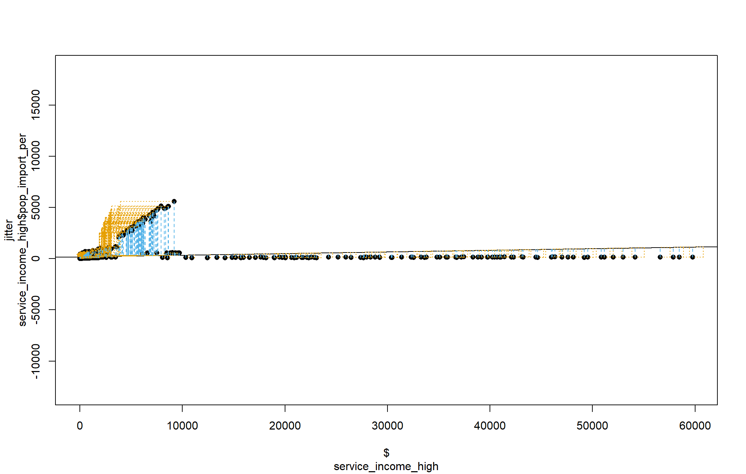
Income Analysis – High Income

Slide 12
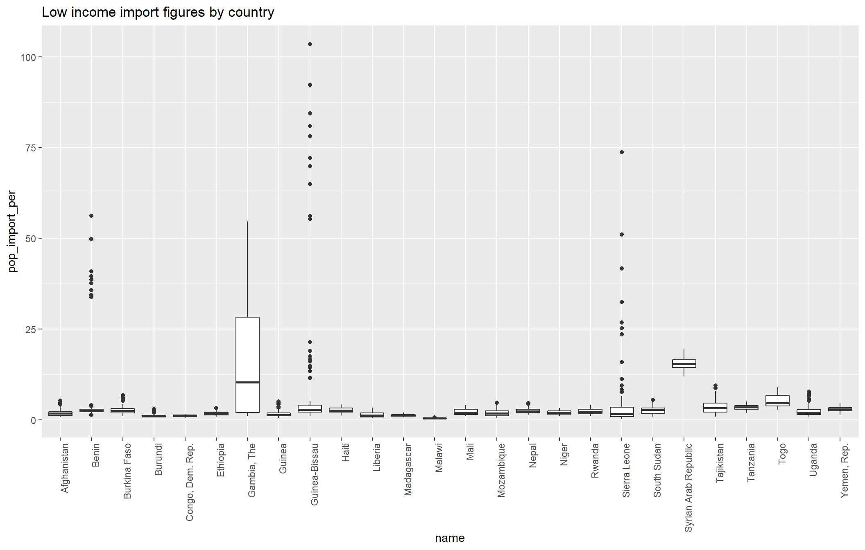
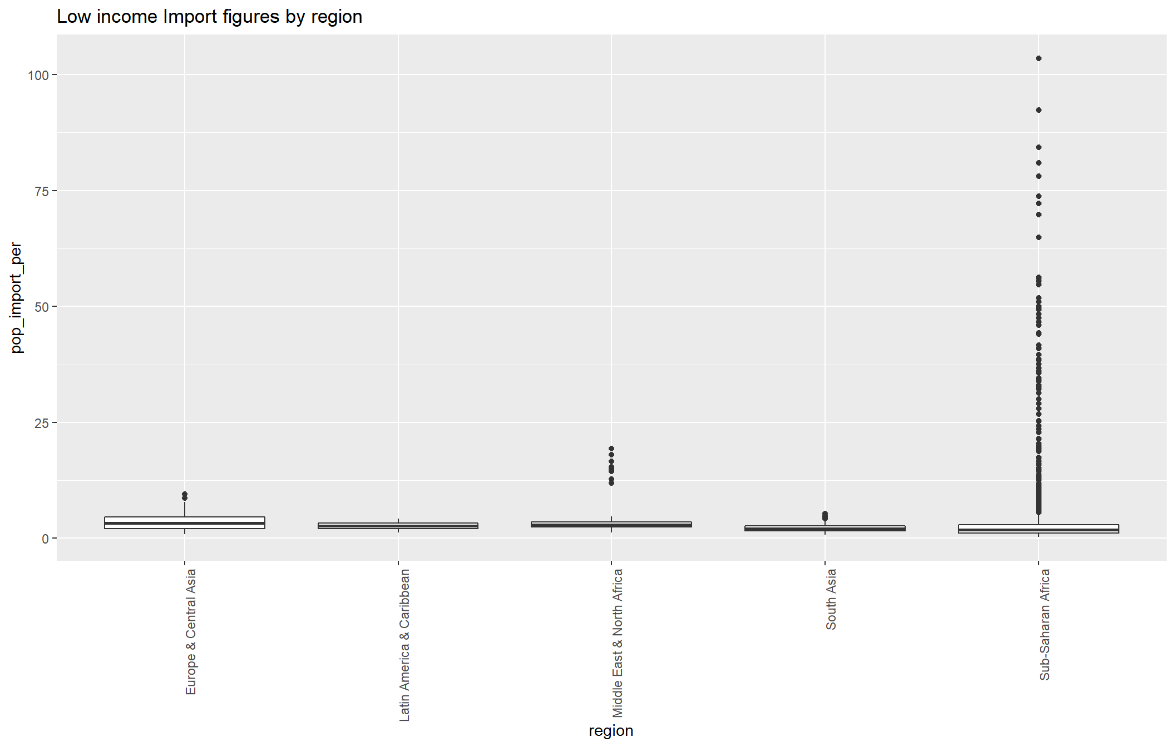
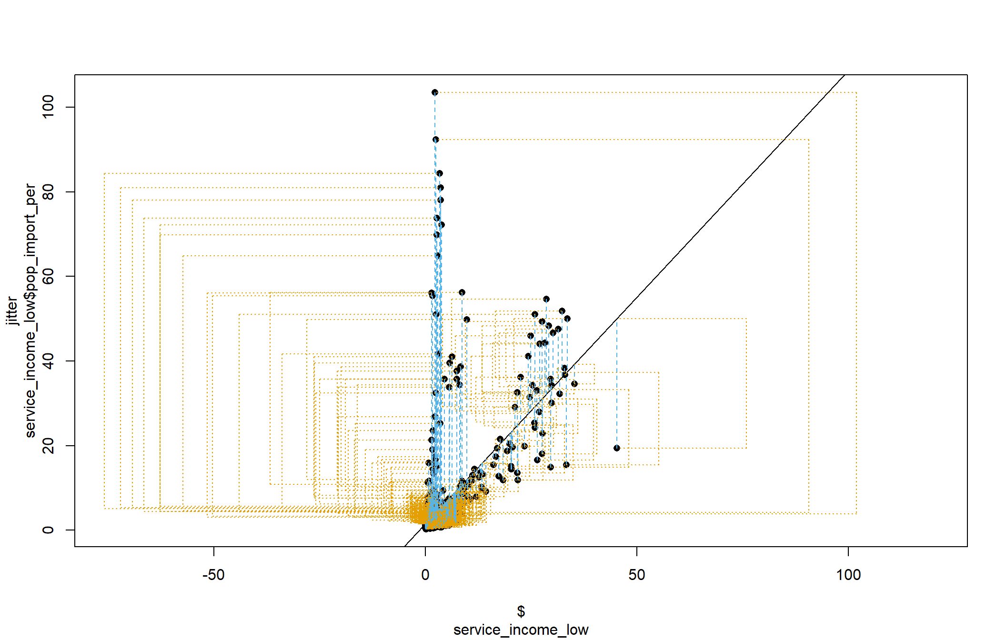
Income Analysis – Low Income
Sub-Saharan Africa
Gambia
Syria

Slide 13
Conclusion
Using this data, I can comfortably conclude there is no correlation between a Country’s Geographical area and/or prosperity figures for their “Computer, communications and other technical services” (import and export) percentage.
Proofs:
Heavy outlines in Low income import and export figures for Sub-Saharan Africa
Guinea and Sierra Leone have import figures far over the rest of the low income aggregate
Gambia and Syria have export figures far over the rest of the low income aggregate
Heavy High Income outlines in import figures for Europe and Central Asia
Lithuania has import figures far over the rest of the High Income aggregate
Heavy High Income outlines in export figures for East Asia & Pacific
Luxembourg has export figures far over the rest of the High Income aggregate
All r2 models show nearly ZERO leading to no correlation (Poor fit)
Questions?
Notes:
In order to give a more accurate model, new aggregates would have to be defined based on other factors such as population and small geographical areas

